Slide 1


Final Project - WAR

Slide 2
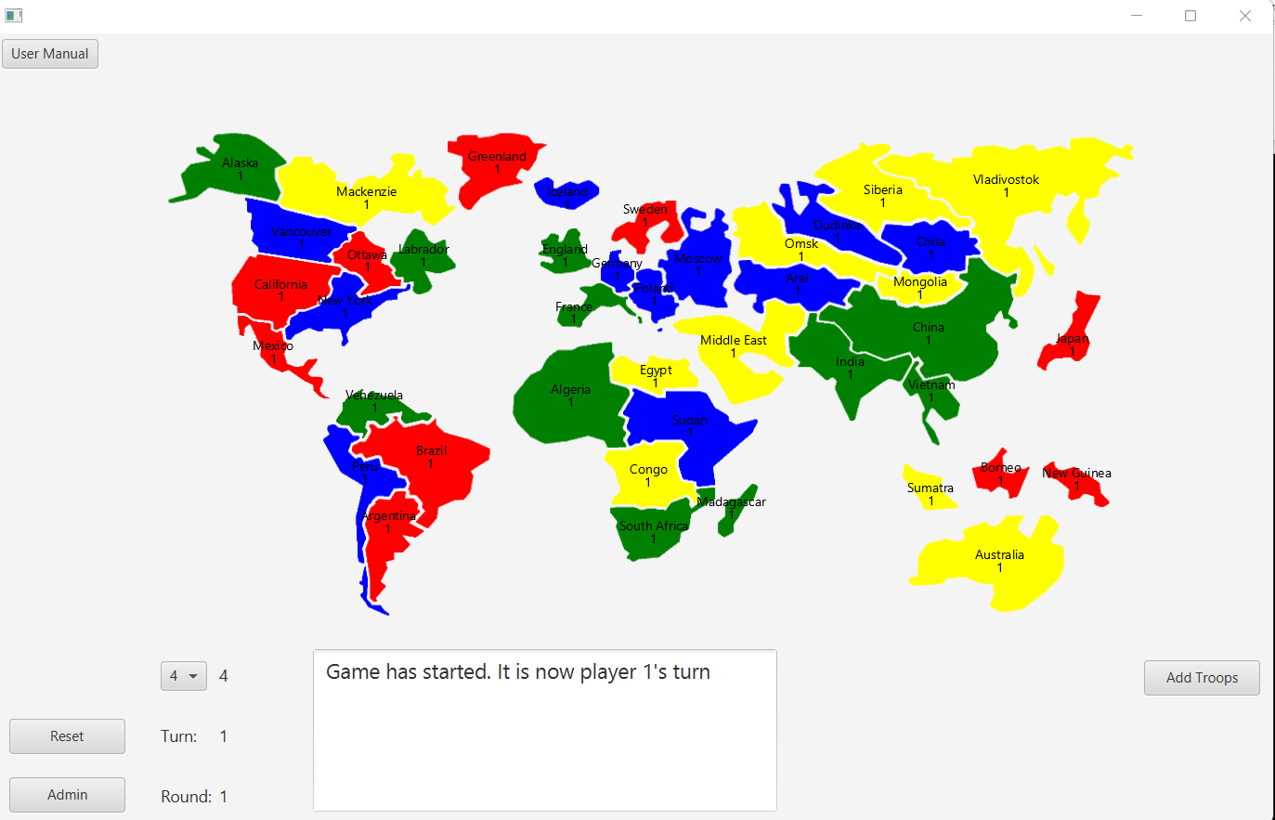
Welcome to WAR!
- WAR is a digital board game where players strategize and battle to conquer territories around the world.

Slide 3
- Each territory is initially assigned with a color, representing the player who owns that territory.
- When you are ready to play, simply launch the App class program, which should generate a new window.
- Select the number of players you wish to partake in the game (3 to 6) and press the 'Start Game' button to get started (as shown in the text box at the bottom of the window).
- In the first round, all players should be able to add troops (half the amount of their owned territories) to their territories, in whatever territory - in their possession - that they may want.
- Once all players are done adding their troops, and the 2nd round has been reached, players must add troops and attack a neighboring country in order to expand their amount of territories.
- The first player to get to 24 territories in their possession wins.

Slide 4
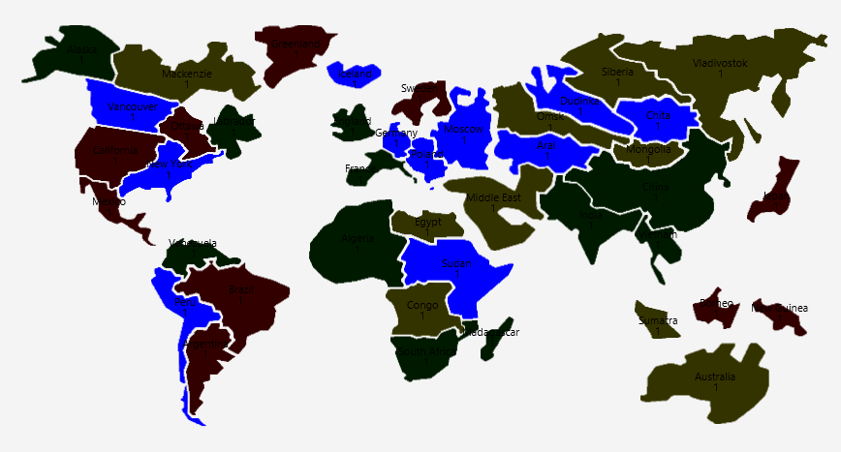
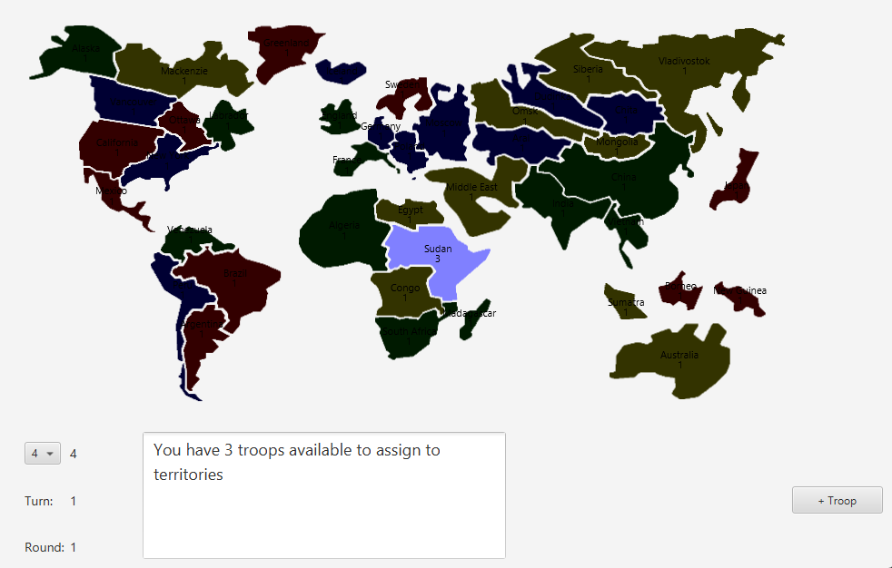
In adding troops mode:
- In the first round, all players should be able to add troops (half the amount of their owned territories) to their territories, in whatever territory - in their possession - that they may want.
- Clicking on the “add troops” button will highlight all the current player’s territories to let them know where they can add troops.
- Click on one of those and press “+ troops” to add troops to that territory.

Slide 5
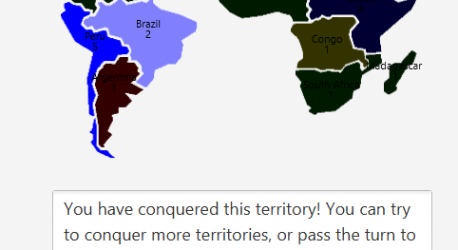
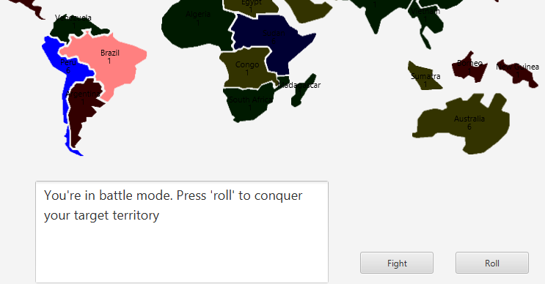
Conquering territories:
To conquer a territory, players must:
1. Select one of the territories they own.
2. Select a neighboring territory (that they do not own) as a target territory.
3. Press the 'fight' button to enter fighting mode.
4. Press 'roll' to roll dice and see how many battles you won.
5. If all enemy troops in the target territory (score on top of each territory) have been defeated.
6. The target territory will now be in your possession and will be assigned to your color.
7. Once this is done, click on your initial territory to deselect it and keep playing.
If you are done attacking other territories, or do not wish to attack at all, simply hit 'finish turn' after you are done adding your troops to pass on the turn to the next player.

Slide 6
Rulebook:
Rules:
1. All players begin with one troop in each of their territories.
2. Each round, every player gets to add new troops to their territories.
3. Players only get to attack from the 2nd round and on.
4. Players can only attack other territories once they have added their troops.
5. You can only attack another territory if your current territory has more than one troop on it.
6. There are 3 available dice for both attack and defense
6.1 The amount of dice is determined by the amount of people in the selected territory and the target territory.
6.2 To determine who wins the dice roll, the highest attack die is compared to the highest defense die, and so on.
6.3 If a defense die is higher than or equal to an attack die, attack will lose 1 of their current troops
6.4 Otherwise, the defending territory will lose one of their troops, until they have none left to lose and the target territory becomes property of the attacker.
7. To win, a player must own 24 territories.

Slide 7
THANK YOU FOR PLAYING WAR!

